Slide 1

Build an Android App – Week 2
Jon Douglas

Slide 2
Last Week Review
Did you install Android Studio or Visual Studio?
How did it go? Any issues?
Tooling is one giant hurdle. Once you get past installing and deploying, you’re ready to make apps!
Remember what Views we discussed and what they do?
Were you able to get through Lab #1?
If not, what problems did you have?

Slide 3
Week 1 Summary
We had a high level view of what Android is, what tooling we can use to develop applications, and the basics of `Views` and `ViewGroups`. We ended our last session with a quick tour of Android Studio and the Android Designer.

Slide 4
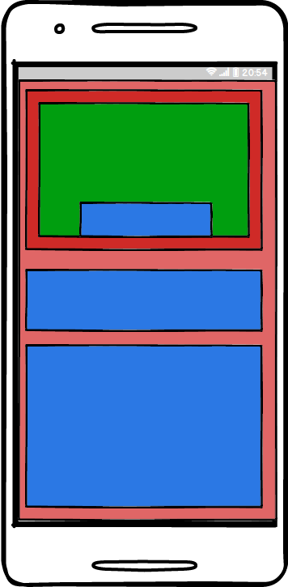
Nested ViewGrouops
Easy to understand
Organizes ViewGroups according to what they need to do on screen.
Gives a better overview of your View Hierarchy.

Slide 5
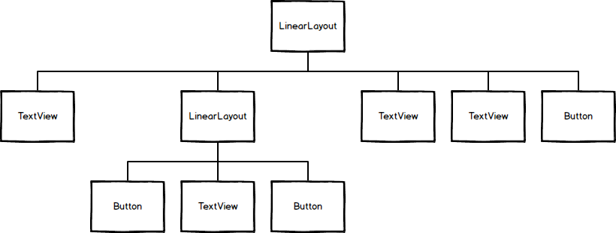
View Hierarchy
Useful to draw out and figure out what ViewGroups you will need in a screen.
At a glance shows how deep or nested your ViewGroups are.
Can help turn difficult layouts into simple to understand ones.

Slide 6
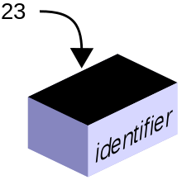
Variables
In programming there is a concept called `variables`. `Variables` are contains that hold a `value` such as a number or piece of text. `Variables` should be named according to what it's holding.

Slide 7
Integer
Stores numbers
Can be positive or negative
32 bit (2³²)
- 2,147,483,647 to 2,147,483,647 int scoreCounter = 0;
1
-3
5

Slide 8
Strings
Stores text
Sequence of characters
Can add strings together C#: string titleCaption = "Title"; Java: String titleCaption = "Title";
Jon
Bob
Barry

Slide 9
Variable Syntax
{Data Type} {Variable Name} {Assignment Operator} {Initial Value}
EX:
int myInteger = 0;
Notes:
CMD+OPTION+8 TO ZOOM

Slide 10
Operations on Integers
+= - Addition Assignment -= - Subtraction Assignment EX: int addToMe = 0; addToMe += 1; Same as: int addToMe = 0; addToMe = addToMe + 1;
Notes:
CMD+OPTION+8 TO ZOOM

Slide 11
Methods
A `Method` is a list of instructions that will run when invoked inside of your code. For example, you might define an `Add` method which takes a number and adds it to another. public int Add(int number) { //Code to add one integer to another and return the added integer }
Notes:
CMD+OPTION+8 TO ZOOM

Slide 12
OnCreate Method
The `OnCreate` method is a special method in Android that is called when the application is fully loaded and ready to start. When adding custom code, you will be adding it in this method majority of the time.
@Override protected void onCreate(Bundle savedInstanceState) { }
Notes:
CMD+OPTION+8 TO ZOOM

Slide 13
Finding Views via Code
What if we wanted to interact with our `View` objects? We need a way to get them inside our code. We can get a `reference` to the `View` object by using the `FindViewById` method. Button buttonAdd = (Button) findViewById(R.id.buttonAdd);
Notes:
CMD+OPTION+8 TO ZOOM

Slide 14
Setting up a Click Listener
Android uses a concept of `Listeners` which is an event listener pattern. These are typically a single event callback that is invoked when the `View` is interacted with. EX: Button buttonAdd = (Button) findViewById(R.id.buttonAdd);
buttonAdd.setOnClickListener(new View.OnClickListener() {
@Override
public void onClick(View v) {
//What happens in our onclick?
}
});
Notes:
CMD+OPTION+8 TO ZOOM

Slide 15
Quiz #1
What technique can we use to disect a layout? (Hint: Think how we can draw a layout out)
Notes:
CMD+OPTION+8 TO ZOOM

Slide 16
Quiz #1 - Answer
View Hierarchy Approach
Notes:
CMD+OPTION+8 TO ZOOM

Slide 17
Quiz #2
What are some reasonable names for a variable that holds the score for the away team at a basketball game?
Notes:
CMD+OPTION+8 TO ZOOM

Slide 18
Quiz #2 - Answer
awayTeamScore
awayTeamPoints
awayScore
Notes:
CMD+OPTION+8 TO ZOOM

Slide 19
Quiz #3
What method does majority of your code belong in?
- OnStart
- OnCreate
- OnPause
- OnDestroy
Notes:
CMD+OPTION+8 TO ZOOM

Slide 20
Quiz #3 - Answer
OnCreate
Notes:
CMD+OPTION+8 TO ZOOM

Slide 21
Quiz #4
What method do you use to get a `View` via code?
Notes:
CMD+OPTION+8 TO ZOOM

Slide 22
Quiz #4 - Answer
FindViewById
Notes:
CMD+OPTION+8 TO ZOOM

Slide 23
Quiz #5
What do we create to handle a `Click` method on a `Button`?
- Listener
- Invoke
- Callback
- Handler
Notes:
CMD+OPTION+8 TO ZOOM

Slide 24
Quiz #5 - Answer
Listener
Notes:
CMD+OPTION+8 TO ZOOM

Slide 25
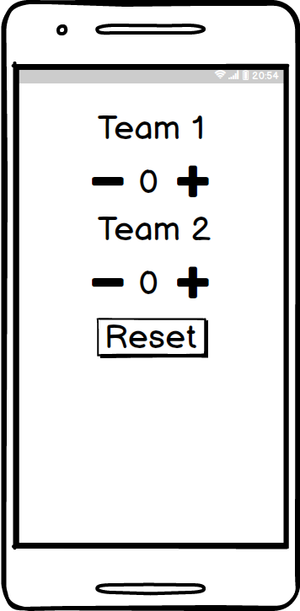
App #2 – Score Counter
Design and implement a score counter to keep track of your favorite sport.
Notes:
CMD+OPTION+8 TO ZOOM

